Slide 1
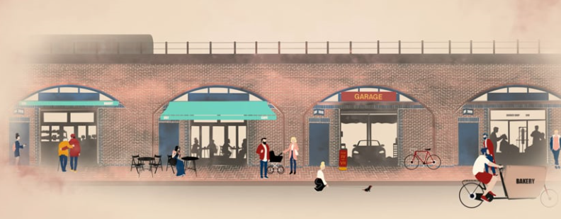

Slide 2
Agenda:
Round of introductions 5 mins
What does Guardians want? 2 mins
Summary to date with thanks 2 mins
Customer presentation 20 mins
Customer feedback since April 2021 (Firoz & Ameen) 5 mins
How do we move forward from here? (Leni & Mael) 5 mins
TfL Management response & discussion 20 mins
Next steps and meeting date

Slide 3
What do we want?
Build an equitable relationship with London Underground & Transport for
London. Landlords and Tenants MUST work in partnership.
An adversarial relationship costs everyone time and money and must stop.
We know good customer service is profitable. The data on revenue from
the CD estate must show this – we wish to make ISR just as sustainable
and profitable too.
Work collaboratively on important shared concerns including:
Ensure compliance with Health, Safety and Fire regulations and all other matters
relating to property management
Urgently work together to better understand and improve the environmental impact
of our SME community.
Evolution and development of policies and processes Inc. Social Value and affordability.
Engagement with tenants in respect of refurbishment and aesthetics.
Work with our members to mutually drive community engagement &
footfall.
Advocate the pioneering approach to customer service, demonstrating a
new sustainable way for Landlords and Tenants to work in partnership in
London.
Drive TfL revenue by increasing occupancy rate (this can be done from
immediate effect as we have long waitlists of SMEs wishing to relocate).

Slide 4
In Summary:
GOTA wrote to City Hall on 12.04.21 Re. Divergence in approach.
Following attempts at dialog, GOTA issued an ultimatum and threat of public action on 15.06.21 with a deadline of 28.06.21 (today).
Negotiations began between GOTA & TfL Leadership Team.
TfL responded on 26.06.21 as follows:
Dear Leni,
Thank you for writing to us and also for taking the time to explore these issues.
As promised, we want to confirm TfL’s updated policy position, which demonstrates our commitment to supporting businesses across our estate with the difficulties imposed by the pandemic and helping small and medium-sized enterprise (SMEs) to drive London’s recovery, whilst ensuring we can generate income to invest in maintaining TfL’s transport infrastructure. Our shared goal in this is to build upon our recent positive engagement with the arches tenant community to create an environment in which TfL can deliver sustainable growth by working in partnership with our tenants.
Our updated policy position on rent reviews and lease renewals is as follows:
Rent Reviews
· We have made the decision to offer further support to all our small and medium tenants by implementing a policy of not increasing rents due for review prior to 31 March 2022.
· After 31 March 2022, any rent increases due will be increased by the formula in the lease which is linked to RPI. This will be applied from 31 March 2022 and will not apply retrospectively.
Lease Renewals
· We have made the decision to offer further support to all our small and medium tenants by implementing a policy to allow our tenants to pay the same rent up to 31 March 2022. Rent renewals after that will take into account current market rates, which will in some cases mean a decrease in rent and in others an increase.
· In offering this support, we will not apply these increases or decreases retrospectively. This means in addition to the significant rent credits we have already provided to our tenants during the pandemic, in real terms rents will also be frozen until March 2022. Tenants will have the reassurance that any historic rent increases due will not be applied.
Given the diverse nature of our estate, the best results will come from us considering the individual circumstances of each tenant within a framework that recognises our responsibility to small business, in line with our commitments to support the Mayor of London’s policies. As part of this, we already make provision for small, independent businesses to apply to surrender their leases on a case-by-case basis where they are able to demonstrate that their financial circumstances are unsustainable. We will ensure that this approach is consistently adopted across the estate, and would welcome your support in early resolution of individual concerns and your constructive input on the development of more detailed policy guidance through collaborative workshops in the coming weeks.
We are taking very seriously the concerns you have highlighted about the need for demonstrable consistency of how this policy will be applied by our property management teams. As discussed, we are jointly committed to resolving this as a matter of urgency so that tenants have a consistent and sympathetic customer experience and you have a single route for engaging with the TfL team. This will be underpinned by upskilling across our surveyor teams, so they all fully understand the demands and financial constraints upon our SME community.
We hope this provides you with reassurance we are listening to you and taking the issues you have raised seriously – and that we are committed to working together to help all of us recover from the pandemic. We recognise and appreciate the support that our tenants have provided to their local communities, especially in recent months. Our tenants have shown remarkable resilience and energy in keeping their businesses running in the most difficult of circumstances. We particularly welcome your ongoing involvement and there is no doubt that you have helped influence our thinking in a way that is positive for us as well as your members.
Kind regards,
Andrew and Graeme

Slide 5
When we avoid difficult conversations,
we trade short-term discomfort
for Long-term dysfunction!

Slide 6
Customer feedback since April 2021:
Negotiations for support have taken far too long.
Despite the evidence, there has been resistance to change LU approach.
Customers have been lied to directly and on record by LU Management.
City Hall has been lied to directly by LU Management.
Guardians of the Arches has been lied to on record by LU Management.
Individuals in the position of influence and decision makers were aware of the failure to administer covid support and had full visibility of the data.
LU have only offered to alter their course of action under threat of public exposure.
Excuses of complexities or politics within TfL have prevented certainty.
Senior Leadership within TfL have been empowering and complicit with the suffering that has taken place.
There is reluctance even now to accept responsibility for the damage done.
Even after customers (via GOTA) have provided detailed evidence of deception and manipulation there is lack of action.
LU proposal of a customer / GOTA relationship manager who doesn't have full operational responsibility to remedy these issues is absurd and counter intuitive – risking exiting trust and productive relationships.
These peoples suffering is REAL.
Their lives have been affected for over a year.

Slide 7
How do we move forward from here?
Andrew Morsley & Graeme Craig take full responsibility for the failures in the past and the future implementation of customer focused policies across the estate.
There must be a shared desire for achievement - Policies and strategies must be universal across the estate in line with CD approach.
As TfL/LU are complex in structure – we must create a strong culture of
accountability.
Operationally:
Dan Lovatt takes both relational and operational responsibility of ISR in order to regulate covid support, train LU staff in CD approach and bring all ISR accounts in line with CD by end of March 2022.
OR
Andrew Morsley & Graeme Craig commit to working with GOTA and the TfL team, specifically under the leadership of Dan Lovatt & Siobhan Jarred to CHANGE THE CULTURE of the LU property team due to their experience in building trust.
We recognise the day-to-day property management team within LU are working hard, its the leadership of this team which must change approach.
As we cannot work on the basis of trust – we must have processes and procedures in place to ensure transparency and clarity on both sides.

Slide 8
How do we move forward from here? Cont.
We request to work with you to deliver the following: **(if DL is given operational control these items will not be required)
ALL ISR customers receive the same and consistent support package as has been applied within the Arches and outside station retail.
All ISR customers are informed in writing of the support available (as applied to all other customers) and apologised to for the experience they have suffered to date.
GOTA, your customers own association, is given appropriate recognition for this rollout of required support now being made available to all.
ALL ISR Customers receive a Business Health Check identical to what has been provided in Arches.
**A confidential complaints process is made available and all customers are informed of how to access this.
**All complaints/escalations are logged, tracked and reported upon to ensure service delivery and communications.
**ALL ISR customers are surveyed - qualitative and quantitative (via independent provider) in the next 8 weeks.
**ALL ISR customers are surveyed again in 3 months later.
**There is a written process for how individual cases can be escalated by GOTA or directly by customers to Graeme Craig & Andrew Morsley as required.
**Procedures to take action against any individual for failures to comply with TfL policies or resistance to change of culture are formalised.
**GC, AM, DL & PR to meet with GOTA quarterly (at a minimum) to report on all matters above and future relationship development.

