Slide 1
PRD - webinar
A brief guide to the new legislation
by Chris Wright - Protected Rent Debt

Slide 2
What is PRD
Protected Rent Debt (or PRD for short) is a new legal term in the COMMERCIAL RENT (CORONAVIRUS) BILL
The act will ringfence any PRD built up as a result of mandated business closures during the “relevant period” whilst establishing a new binding arbitration process aimed at finding a proportionate solution which protects jobs, prevents further damage to the economy and enables a return to normal commercial relations. Announced on 19/06/21 the minister stated Landlords are expected to make allowances for (PRD) and share the financial impact with their tenants

Slide 3
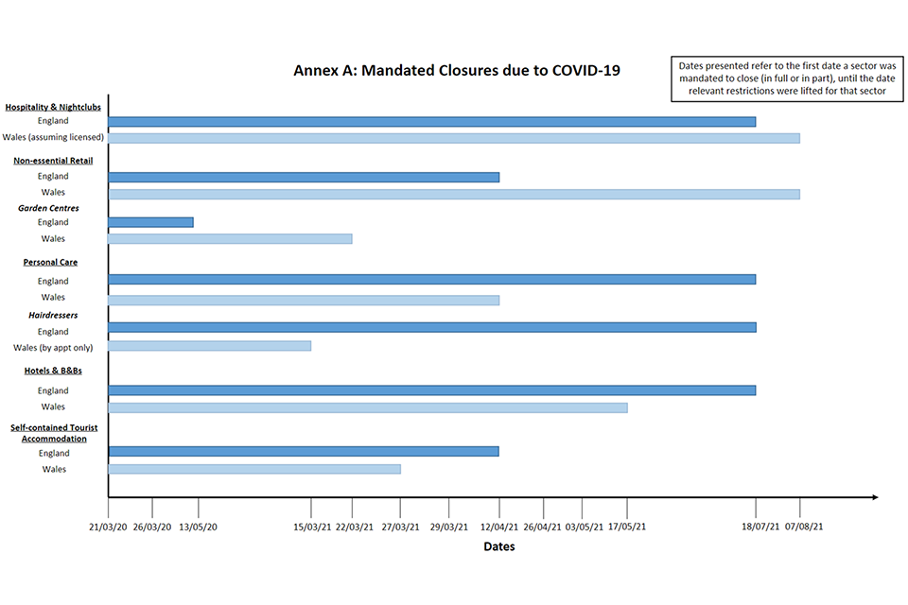
The relevant period 21/03/20 -?

Slide 4
Who is in scope?
Business tenants or guarantors Must be > 1 year L&T agreement and still trading.
Have been closed Partial or full closure is acceptable
Have PRD A debt occurred during the relevant period
Not have PRD in insolvency IVA - CVA - Companies Act 2006 arrangement.

Slide 5
Is PRD just rent?
Rent Rent applied during the relevant period
Insurance Any charges levied under your tenancy agreement
Other services Supplied by a landlord - eg utilities
VAT & Interest Applied to the above

Slide 6
In a deal already?
CVA / IVA / Companies Act You cannot undo insolvency processes
Set-off (using deposits) Either agreed or not they can be looked at in PRD arbitration.
CCJ A money order can be looked at in PRD arbitration
Mutual agreement to repay They can be looked at in PRD Arbitration.

Slide 7
How long?
Bill becomes Law End of March 2022 - COP is live now
Register for Arbitration Then just 6 months to lodge a case.
Arbitration cases A few months, cases may be stacked, depends on demand & no’s of Arb’s
Access to PRD Arbitration Closes 6 months after law passes.

Slide 8
Code of Practice?
COP principles key principles of fairness, affordability, and viability
Annex A Relevant Period table (see earlier slide)
Annex B Evidence under consideration (next)
Annex C Arbitration Process (slide after that)

Slide 9
COP Annex B Evidence
When considering tenant viability and affordability, parties and the arbitrator may wish to take the following non-exhaustive list of factors into account:
existing and anticipated credit/debit balance
business performance since March 2020
tenant’s assets (noting that some may be liquid assets such as cash and other may be plant and machinery which cannot be sold without ending the business)
position of the tenant with other tenancies i.e., ability to absorb the costs within those other tenancies
government assistance received by the tenant including loans and grants (which may not have covered rent but provided some financial support to the business)
dividend and bonus payments to shareholders
excessive or unreasonable dividend payments to directors (having regard for the fact that director dividends may be the director’s only income during the ringfenced period)

Slide 10
COP Annex B Evidence (contd)
overdue invoices or tax demands
unpaid or returned cheques or electronic payments
exceeding overdraft limits
creditor demands
money judgments
expert evidence received as to the tenant’s current trading position, e.g., from the tenant’s accountant
shortfalls in share issues
evidence of prior refusal of further credit, funding, or lending, (although the possibility that the tenant could obtain finance if it has not already applied for it is not to be considered a factor)
failure to meet budget projections
loss of important contracts
insolvency of a major customer
unexpected retentions -knowledge of a lack of working capital, or
loss of key personnel or staff redundancy.

Slide 11
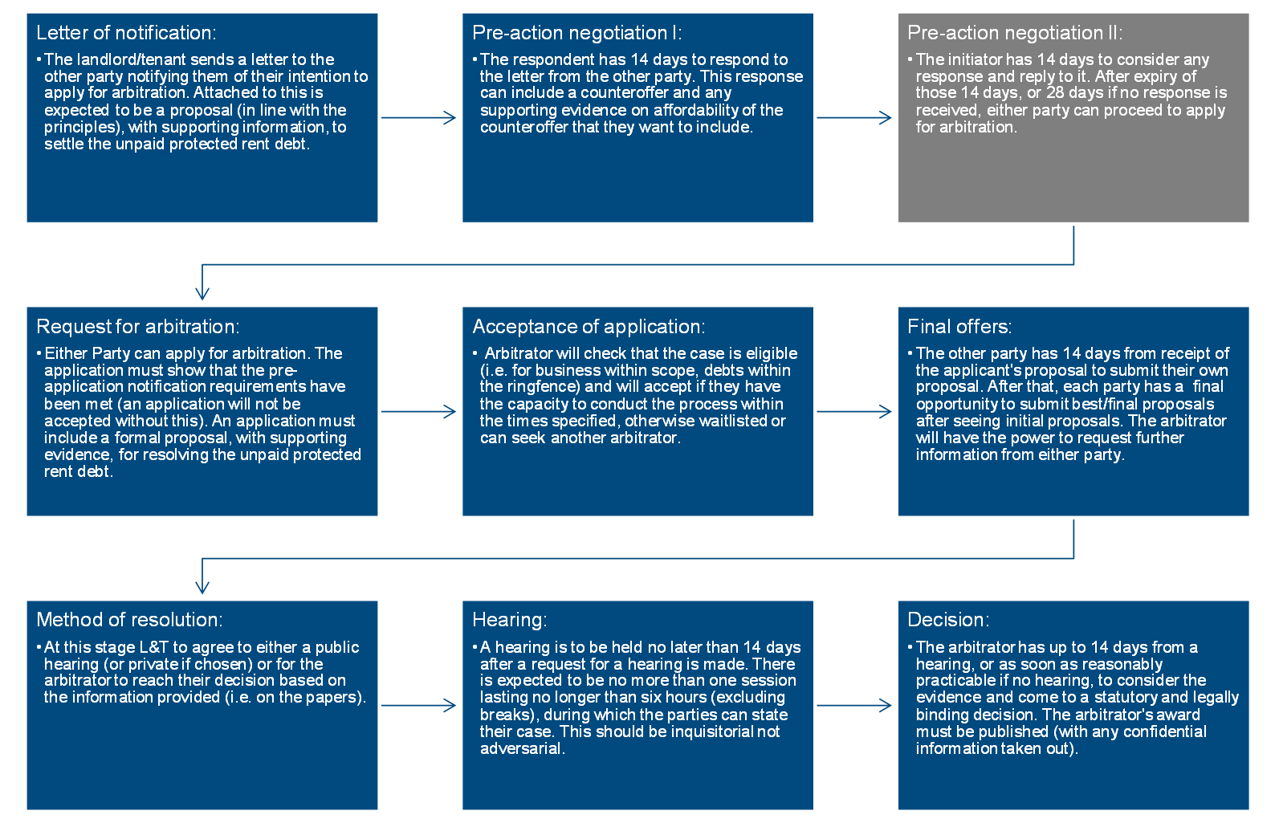
Arbitration Process - COP Annex C

Slide 12
Arbitration process?
Notification to landlord Yes allow 28 days on from notice
Arbitrator appointed This is done by the authorised body, with an upfront fee.
Arbitration on the documents The cases are expected to be on the documents only
Evidence Witness statements as well Annex B.

Slide 13
Costs?
No cost awards made Each party pays their own.
Arbitrator’s fee This is shared equally & can be capped.
Claim your costs In the usual way from year end accounts, include any 3rd party advice.
Cost levied Add costs levied by your landlord related to PRD to any proposal.

Slide 14
Action to take now?
Review current deals Consider if any current deal is better left alone.
Gather evidence Reconcile PRD bills & gather info on any landlord viability / affordability.
Make a proposal early You will have to do this in April - no harm in doing it now - look reasonable.
Non PRD debts Pay down any pre or post “relevant period debts” that are not PRD related.

Slide 15
PRD Milestones
Q4 2021
Q2 2022
Q1 2021
Q3 & 4 2022
Establish PRD amounts, gather evidence, pay down non PRD invoices.
Tenants or Landlords can issue noticies and begin PRD cases.
2021 |  |  |  | 2022
Make early PRD proposal to save on Arbitration costs.
Awards issued, depending on numbers of cases they might have to stack cases into 2023.

Slide 16
The way forward
Do nothing
Landlord can force a PRD arbitration, or wait till clock runs out & they evict you.
DIY
All source documents to download on the PRD site shortly.
Representation
I will be able to represent, you can claim your costs from your year end. Been a stakeholder in pub related legislation, a commercial debt adviser and represented hundreds of businesses in statutory arbitration's.

Slide 17
Thanks for listening!
I hope you found this webinar of use.
You can email us at our new address.
admin@protectedrentdebt.co.uk

